Slide 1
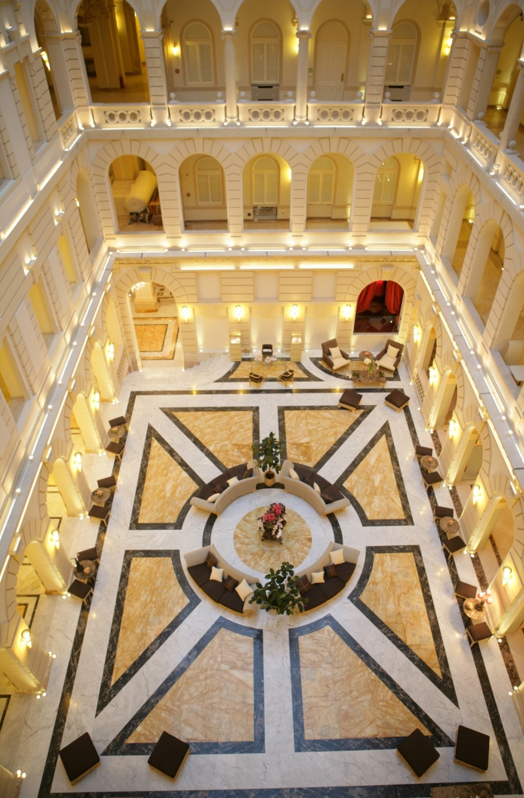
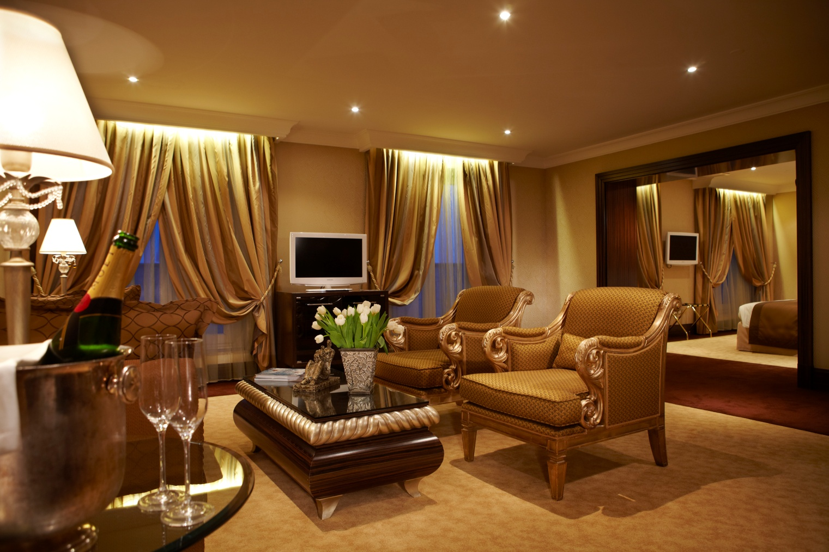
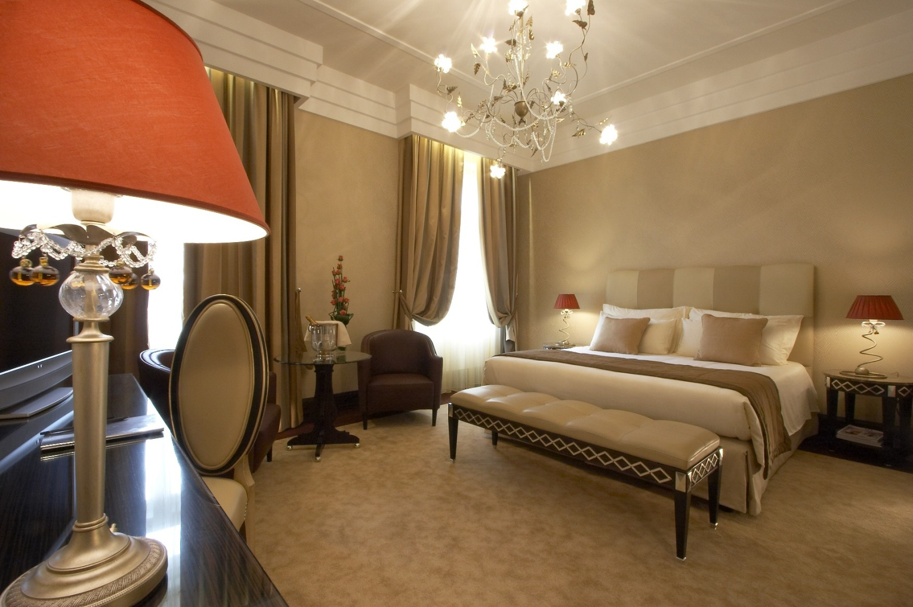
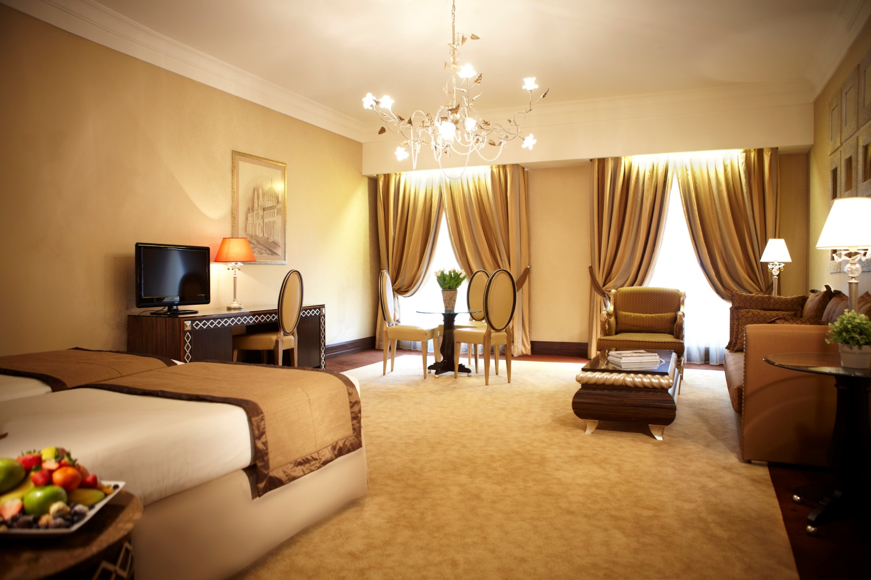
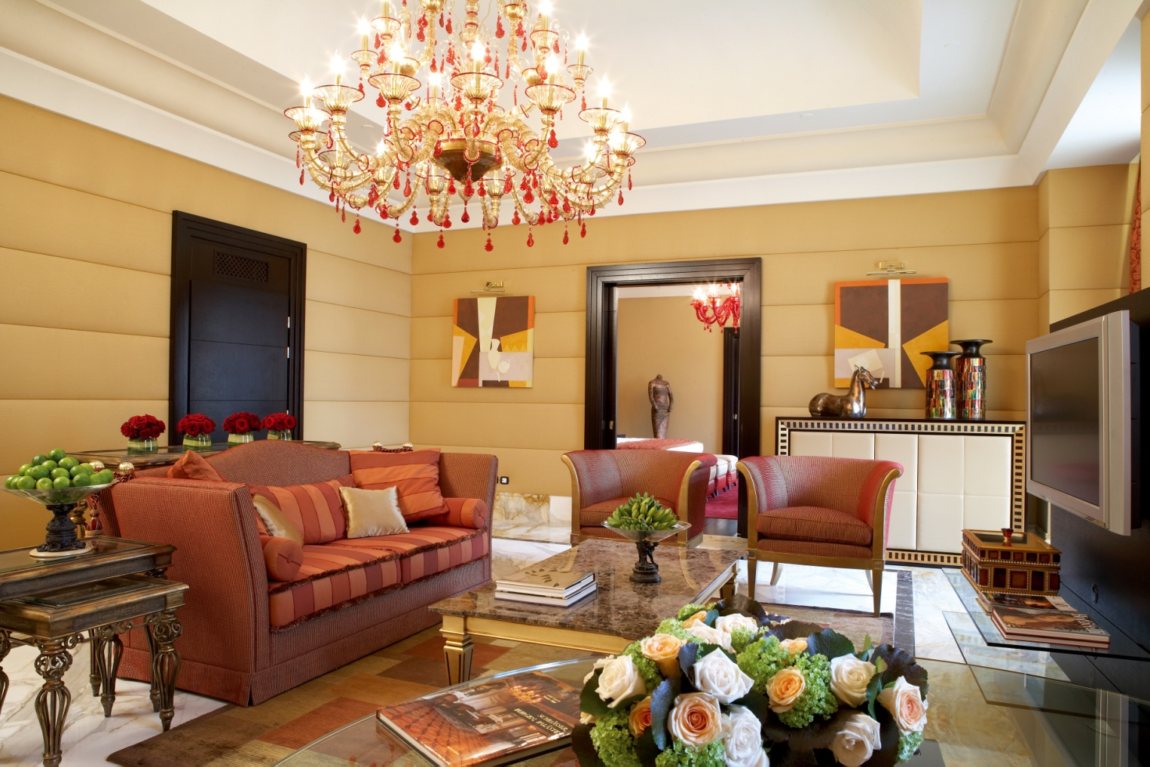
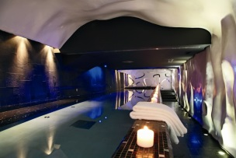
THE MOST BEAUTIFUL PLACE TO STAY
Opened in 1894 the New York Palace was originally commissioned by the New York Insurance Company. It was opened with 185 rooms and suites. The pearl of the New York Palace building is the New York Café which was awarded the ’Most Beautiful Café in the World’ by many city guides.
New York Palace Budapest, Autograph Collection Erzsébet krt. 9-11. Budapest, 1073 - Hungary
Rooms and Suites
Type | Number | Size (m2)
Classic room | 64 | 25-35
Superior room | 45 | 40
Deluxe | 26 | 46-62
Exclusive room | 20 | 46-62
Junior Suite | 21 | 61-70
Executive Suite | 7 | 75-94
Suite Esedra | 1 | 135
Suite Presidential | 1 | 142
Wellness – Spa (8am to 9pm)
Services and Amenities:
6 treatment rooms
Hairsalon
Fitness room
Pool
Sauna
Turkish bathroom
Standard Wi-Fi is complimentary
Business Center
24-hour In-Room Dining
Laundry service
Pillow menu in rooms
Twice-daily housekeeping service
Complimentary mineral water
Nespresso coffee machine in suites
Airport transfers
Limousine transfer service
Valet parking
On request Concierge service
Express check-in/check-out
Check-in at 3pm and check out at 12am
Safety deposit boxes and in-room safe
Refrigerated private bar
Doctor or nurse on call 24 hours a day
All credit cards excepted

Slide 2
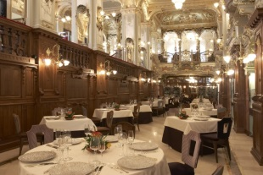
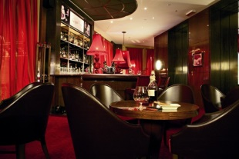
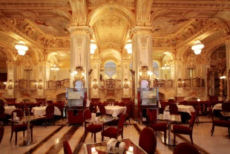
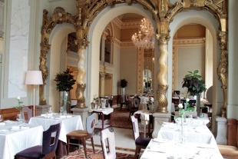
BAR AND RESTAURANTS
Boscolo Budapest, Autograph Collection Erzsébet krt. 9-11. Budapest, 1073 - Hungary
Name | Seats | Opening hours
New York Cafe | 150 | 8:00 – 24:00
Salon Restaurant | 30 | 18:00 – 24:00
Deepwater Restaurant | 130 - 140 | 12:00 – 24:00
Nyugat Bar | 20-25 | 18:00 – 24:00
Meeting rooms
 | DIMENSIONS (M) | SIZE | HIGH (M) | THEATRE | CLASS-ROOM | U-SHAPE | BOARD | BANQUET | COCKTAIL | CABARET
ROMA | 20,9×20,9 | 436,8 | 4,2 | 500 | 180/270 | 44/66 | / | 33/32/320 | 550 | 231/288
ROMA FOYERS | 31,77×11,25 | 770 | 6,24 | / | / | / | / | / | 450 | /
PRAGUE | 4,9×13,4 | 66 | 2,55 | 70 | 24/36 | 20/30 | 16/24 | 5/4/40 | 50 | 35/36
VENEZIA | 5,23×13 | 67 | 2,55 | 70 | 24/36 | 20/30 | 16/24 | 5/4/40 | 50 | 35/36
ROMA+PRAGUE+ VENEZIA | 31,03×29,9×7 | 570 | / | / | / | / | / | 480 | 650 | /
BUDAPEST | 9,5×5,9 | 56,05 | 2,75 | 50 | 20/30 | 16/24 | 16/24 | 4/3/30 | 40 | 28/27
ROSSINI | 31,87×5,6 | 180 | 2,9 | 150 | 40/60 | 44/66 | 40/60 | 10/9/99 | 160 | 70/81
VIVALDI | 22,5×5,6 | 127,21 | 3,3 | 120 | 46/69 | 40/60 | 36/57 | 9/8/80 | 120 | 63/72
PUCCINI | 5,28×7,46 | 39,42 | 2,98 | 56 | 22/33 | 16/24 | 12/18 | 4/3/30 | 30 | 28/27
VERDI | 5,32×8,14 | 43,3 | 2,98 | 56 | 22/33 | 16/24 | 12/18 | 4/3/30 | 40 | 28/27
BELLINI | 8,45×5,6 | 47,6 | 3 | 48 | 20/30 | 16/24 | 12/18 | 3/2/20 | 40 | 21/18
DONIZETTI | 8,6×5,6 | 48 | / | 40 | 20 | 25 | 20 | 30 | 40 | 6
MONTEVERDI | 14,49×5.5 | 80 | 3,8 | 96 | 28/42 | 28/40 | 20/30 | 5/4/x | 50 | 35/36
LOBBY AREA | 21,2×13,74 | 291 | 30 |  |  |  |  | x/20/200 | 250
WHITE SALON | 12,44×5,24 | 65,28 | 5 | 90 | / | 20/30 | 16/20 | 5/5/55 | 100 | 35/45
RED SALON | 5,6×8 | 45,8 | 5,08 | 60 | / | 16/24 | 12/14 | 3/3/33 | 40 | 21/27

